Slide 1
Python for AI (Loan Default)
TTT

Slide 2
Basic Command
a=1
a=1.68
a="hello“
a=[1,3,4,6]
print(a[2])
print("the array is : ", a)
name = input("Please enter your name : ")
print("Your name is ", name)
a = 1
while a < 5:
print(a)
a = a+1
a=3
if a==1:
print("a is 1")
elif a==2:
print("a is 2")
else:
print("a is not 1 or 2")

Slide 3
Library
Pandas
numpy
scipy
sklearn

Slide 4
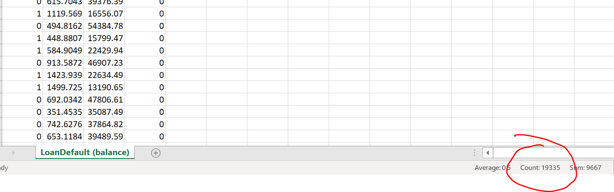
Check Data Imbalance
=COUNTIF(A2:A10001, "No")
Use Smote to make the data balance
pd.set_option('display.max_rows', None, 'display.max_columns', None)
pd.set_option('display.max_rows', 10, 'display.max_columns', 10)
Or
pd.set_option('display.max_rows', 500)
pd.set_option('display.max_columns', 500)
pd.set_option('display.width', 1000)

Slide 5
from collections import Counter
from imblearn.over_sampling import SMOTE
from imblearn.under_sampling import RandomUnderSampler
import pandas
df=pandas.read_csv("C:/Users/Teoh Teik Teo/OneDrive - TSS Global Pte. Ltd/TT Library/AI Model/Data/LoanDefault.csv")
print(df)
counter(df["default"])
df = df.replace(("Yes", "No"), (1,0))
X=df
X=df.drop("default", axis=1)
print(X)
y=df.loc[:, "default"]
print(y)
counter = Counter(y)
print(counter)
oversample = SMOTE()
X, y = oversample.fit_resample(X, y)
# summarize the new class distribution
counter = Counter(y)
print(counter)
df=pandas.concat([X, y], axis=1)
df.to_csv("LoanDefault (balance).csv", index=0)

Slide 6
import pandas as pd
df = pd.read_csv("LoanDefault (balance).csv")
#select column
df = df.loc[:, ["default", "student", "balance", "income"]]
print(df)
Alternatively
#select column
df = df.iloc[:, 0:4]
print(df)
#remove na
df=df.dropna()
print(df)
#Optional replace with number
df['default'] = df["default"].replace(("Yes", "No"), (1,0))
print(df)
#remove not a number
for i in df.columns:
df1 = pd.to_numeric(df[i], errors='coerce’) #this is to force any non-numeric to null
f = df1.notnull() #to set the flag false if it is a null
df=df[f] #copy only not null to df, or remove null
print(df)
Data Wrangling

Slide 7
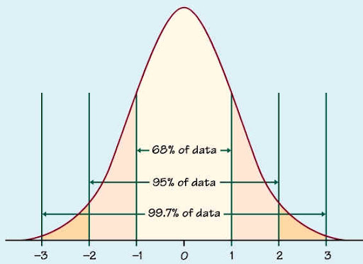
#remove outlier
import numpy as np
from scipy import stats
z = stats.zscore(df.astype(np.float)) #zscore conversion need float
z = np.abs(z) #convert all to positive because the parity is not important
f = (z < 3).all(axis=1) #3 is your choice, axis =1 means by columns, f is a flag
df = df[f]
Data Wrangling
Data Visualization (Not all column are applicable, depends on library)
df.describe()
#import matplotlib.pyplot as plt
df.hist()
df.boxplot()
Double precision numbers have 53 bits (16 digits) of precision and regular floats have 24 bits (8 digits) of precision.
df.corr()
import seaborn as sns
sns.heatmap(df.corr())
axis=1 (or axis='columns') is vertical axis

Slide 8
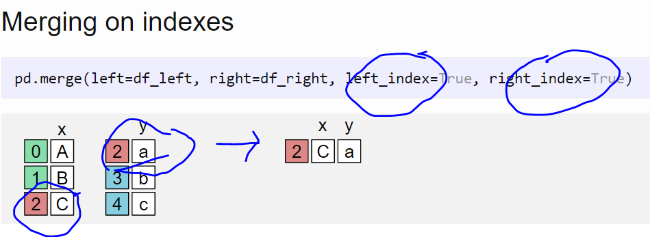
X = df.loc[:,["student", "balance", "income"]]
Y = df.loc[:, "default"]
print(X,Y)
Alternatively:
X=df
X=df.drop("default", axis=1)
Or:
X=df.iloc[:,1:4]
#normalization
from scipy import stats
import numpy as np
pd.set_option('display.max_rows', 10)
for i in X.columns:
X[i]=stats.zscore(X[i].astype(np.float))
print(X)
Data Wrangling
https://www.andreaamico.eu/data-analysis/2019/12/10/pandas_merge.html
#for categorical input, dummy or one hot encoding
dummy=pd.get_dummies(X["student"])
X=X.merge(dummy, left_index=True, right_index=True)
X=X.drop("student", axis="columns")

Slide 9
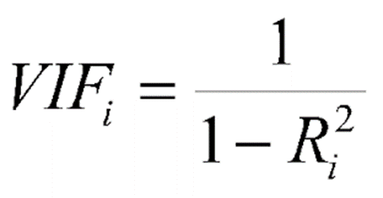
#vif to check colinearlity
#1 = not correlated.
#Between 1 and 5 = moderately correlated.
#Greater than 5 = highly correlated.
from statsmodels.stats.outliers_influence import variance_inflation_factor
vif_data = pd.DataFrame()
vif_data["feature"] = X.columns
vif_data["VIF"] = [variance_inflation_factor(X.values, i) for i in range(len(X.columns))]
print(vif_data)

Slide 10
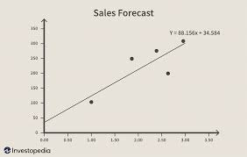
#split train test
from sklearn.model_selection import train_test_split
X_train, X_test, Y_train, Y_test = train_test_split(X, Y, test_size=0.3)
print(X_train, X_test, Y_train, Y_test)
Regression
from sklearn import linear_model
from sklearn.metrics import confusion_matrix
model=linear_model.LogisticRegression()
model.fit(X_train, Y_train)
pred=model.predict(X_train)
cm = confusion_matrix(Y_train, pred)
print(cm)
accuracy = (cm[0,0] + cm[1,1])/sum(sum(cm))
print(accuracy)
pred=model.predict(X_test)
cm = confusion_matrix(Y_test, pred)
print(cm)
accuracy = (cm[0,0] + cm[1,1])/sum(sum(cm))
print(accuracy)

Slide 11
from sklearn import linear_model
from sklearn.metrics import confusion_matrix
import numpy as np
model=linear_model.LogisticRegression()
model.fit(X_train, Y_train)
THRESHOLD = 0.45
pred = model.predict_proba(X_train)
# [:,1] taking all rows (:) but keeping the second column (1) proba return 2 columns
pred = np.where(pred[:,1] > THRESHOLD, 1, 0)
cm = confusion_matrix(Y_train, pred)
print(cm)
accuracy = (cm[0,0] + cm[1,1])/sum(sum(cm))
print(accuracy)
pred=model.predict(X_test)
pred = model.predict_proba(X_test)
# [:,1] taking all rows (:) but keeping the second column (1) proba return 2 columns
pred = np.where(pred[:,1] > THRESHOLD, 1, 0)
cm = confusion_matrix(Y_test, pred)
print(cm)
accuracy = (cm[0,0] + cm[1,1])/sum(sum(cm))
print(accuracy)
If you need to set threshold, use predict_prob

Slide 12
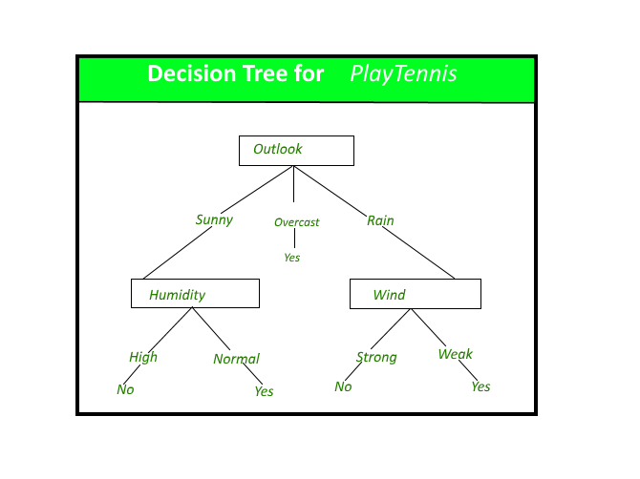
Decision Tree
from sklearn import tree
model=tree.DecisionTreeClassifier(max_depth=4)
model.fit(X_train, Y_train)
pred=model.predict(X_train)
cm = confusion_matrix(Y_train, pred)
print(cm)
accuracy = (cm[0,0] + cm[1,1])/sum(sum(cm))
print(accuracy)
pred=model.predict(X_test)
cm = confusion_matrix(Y_test, pred)
print(cm)
accuracy = (cm[0,0] + cm[1,1])/sum(sum(cm))
print(accuracy)

Slide 13
Feature Ranking
fr = model.feature_importances_
print(fr)

Slide 14
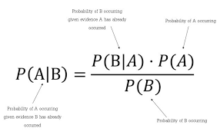
Naïve Bayesian
from sklearn.naive_bayes import GaussianNB
model=GaussianNB()
model.fit(X_train, Y_train)
pred=model.predict(X_train)
cm = confusion_matrix(Y_train, pred)
print(cm)
accuracy = (cm[0,0] + cm[1,1])/sum(sum(cm))
print(accuracy)
pred=model.predict(X_test)
cm = confusion_matrix(Y_test, pred)
print(cm)
accuracy = (cm[0,0] + cm[1,1])/sum(sum(cm))
print(accuracy)

Slide 15
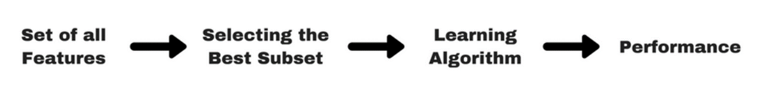
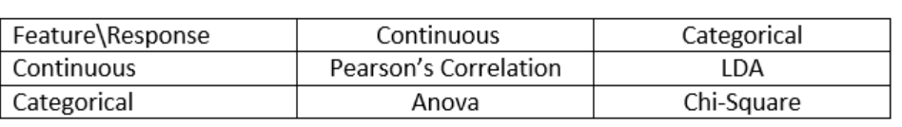
Feature Engineering (important for linear regression)

Slide 16
import pandas as pd
import numpy as np
data = pd.read_csv("C:/Users/Teoh Teik Teo/OneDrive - TSS Global Pte. Ltd/TT Library/AI Model/Data/Diabetes.csv")
data.columns
X = data.iloc[:,0:8]
Y = data.iloc[:,8]
from sklearn.feature_selection import SelectKBest, chi2
features = SelectKBest(score_func=chi2, k=5)
fit = features.fit(X, Y)
print(data.columns, fit.scores_)
mask = fit.get_support()
print(mask)
new_features = X.columns[mask]
print(new_features[:])
X = data.loc[:,['Number of times pregnant', 'Plasma glucose concentration a 2 hours ', '2-Hour serum insulin ', 'Body mass index ', 'Age']]

Slide 17
from sklearn import linear_model
model = linear_model.LogisticRegression()
model.fit(X,Y)
pred = model.predict(X)
from sklearn.metrics import confusion_matrix
cm = confusion_matrix(Y, pred)
accuracy = (cm[0,0] + cm[1,1])/sum(sum(cm))
Print(accuracy)
print(model.coef_)

Slide 18
Select Features (Continuous)
import pandas as pd
import numpy as np
data = pd.read_csv("Treynor.csv")
data.columns
data = data.dropna()
X = data.iloc[:,16:30]
Y = data.iloc[:,-1]
from sklearn.feature_selection import SelectKBest, f_regression
features = SelectKBest(score_func=f_regression, k=5)
fit = features.fit(X, Y)
print(data.columns, fit.scores_)
mask = fit.get_support()
print(mask)
new_features = X.columns[mask]
print(new_features[:])

Slide 19
# print more columns, rpows
import pandas as pd
pd.set_option('display.max_rows', 500)
pd.set_option('display.max_columns', 500)
pd.set_option('display.width', 1000)

